Slide 1
DISTRIBUTED SYSTEMS Principles and Paradigms Second Edition ANDREW S. TANENBAUM MAARTEN VAN STEEN Chapter 4 Communication

Slide 2
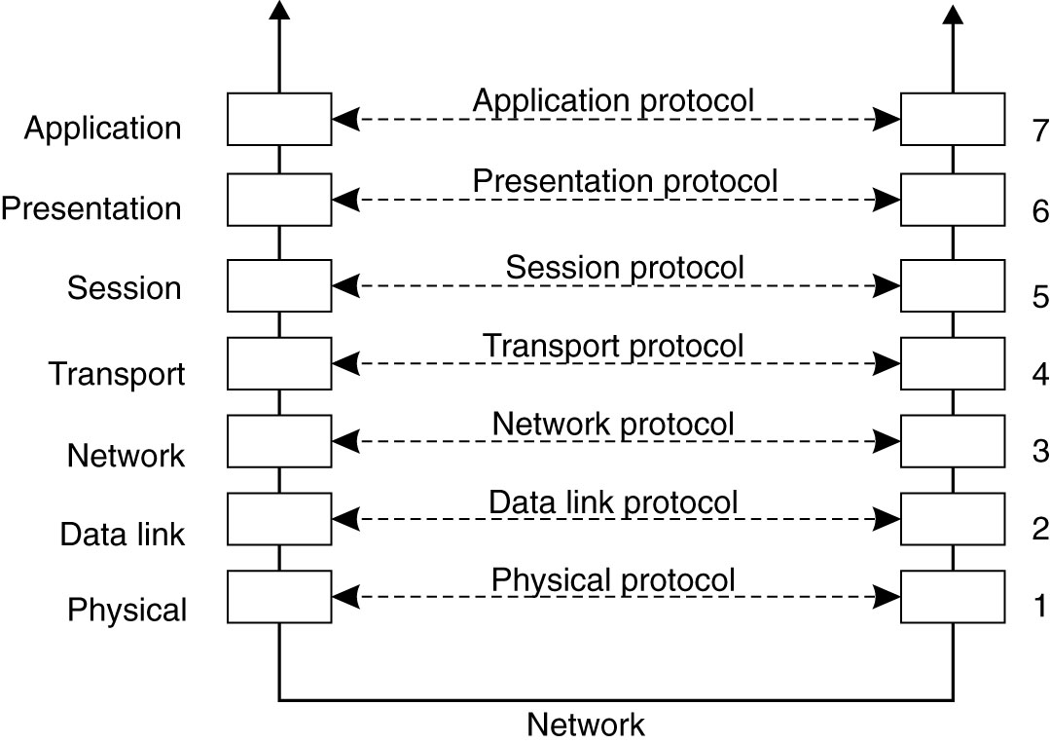
Layered Protocols (1)
Figure 4-1. Layers, interfaces, and protocols in the OSI model.

Slide 3
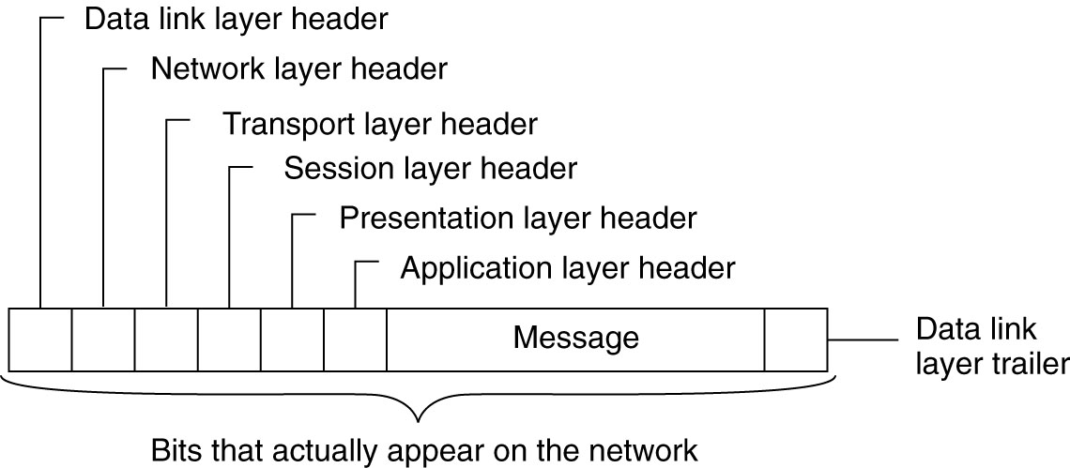
Layered Protocols (2)
Figure 4-2. A typical message as it appears on the network.

Slide 4
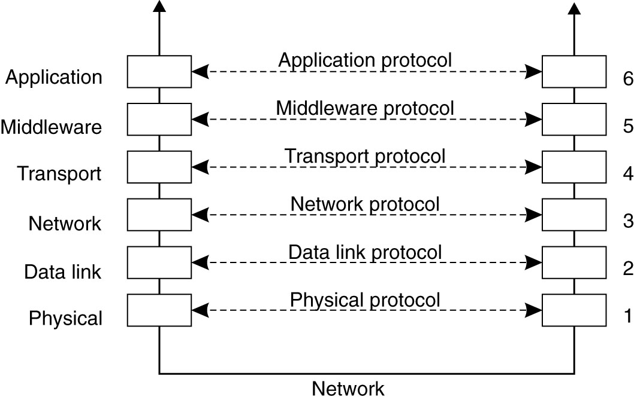
Middleware Protocols
Figure 4-3. An adapted reference model for networked communication.

Slide 5
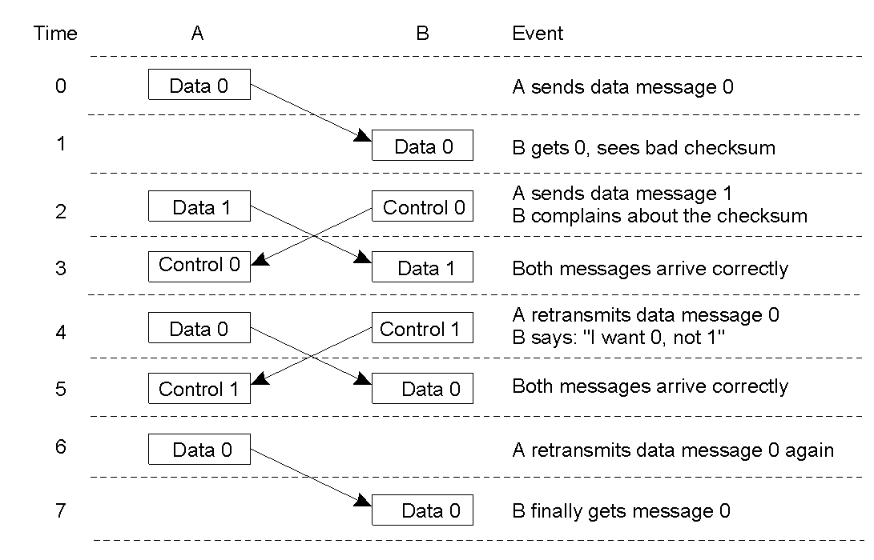
Data Link Layer (ed. 1)
2-3
Discussion between a receiver and a sender in the data link layer.

Slide 6
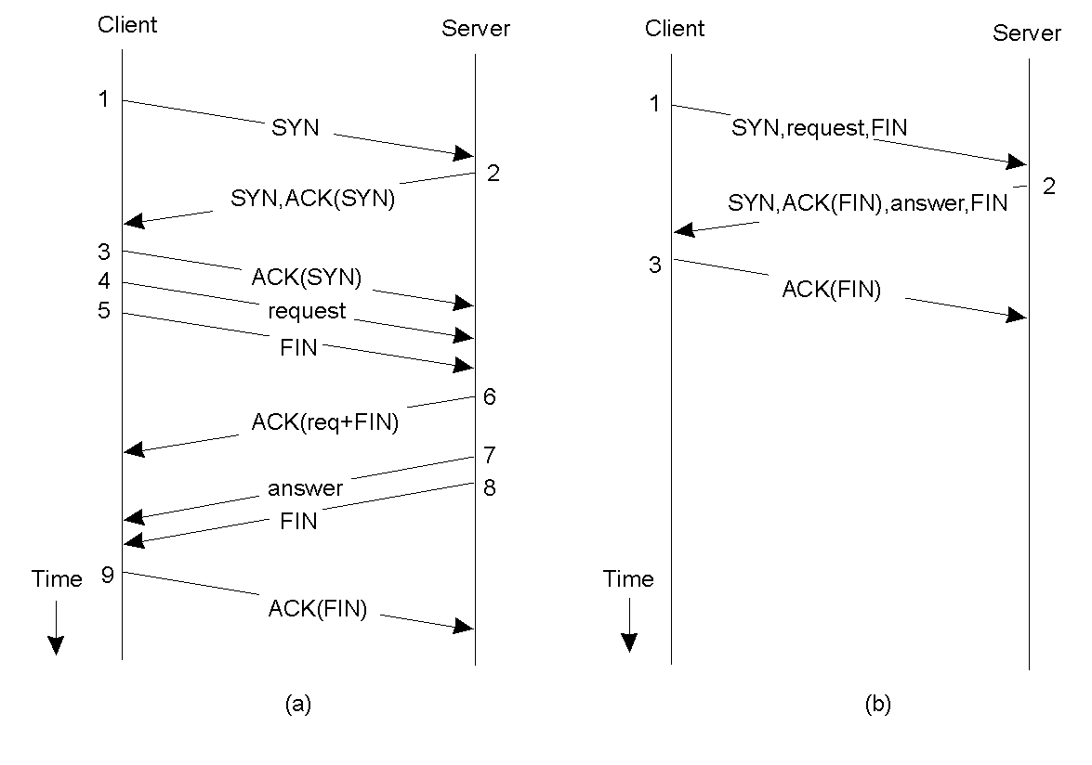
Client-Server TCP (ed. 1)
2-4
Normal operation of TCP.
Transactional TCP.

Slide 7
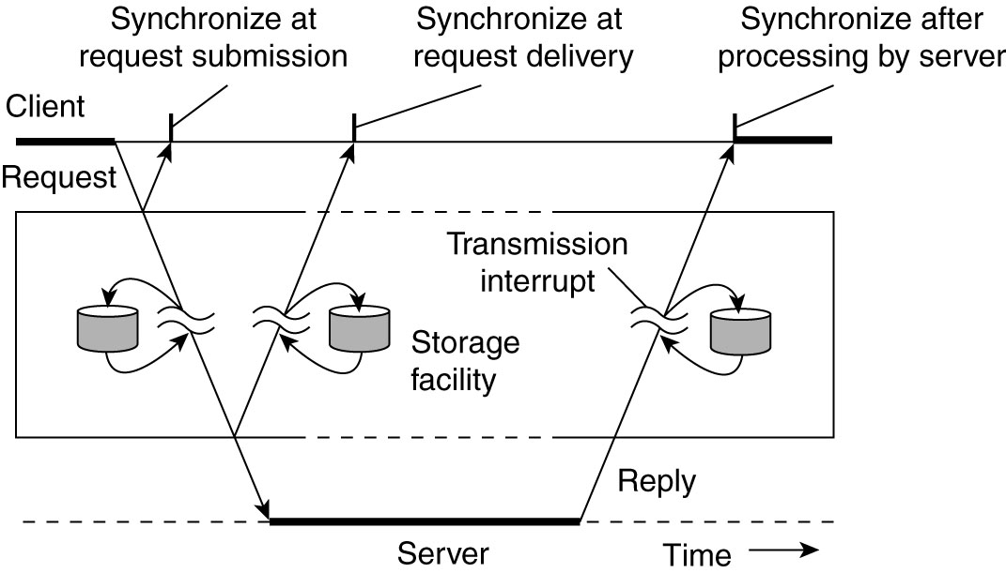
Types of Communication
Figure 4-4. Viewing middleware as an intermediate (distributed) service in application-level communication.

Slide 8
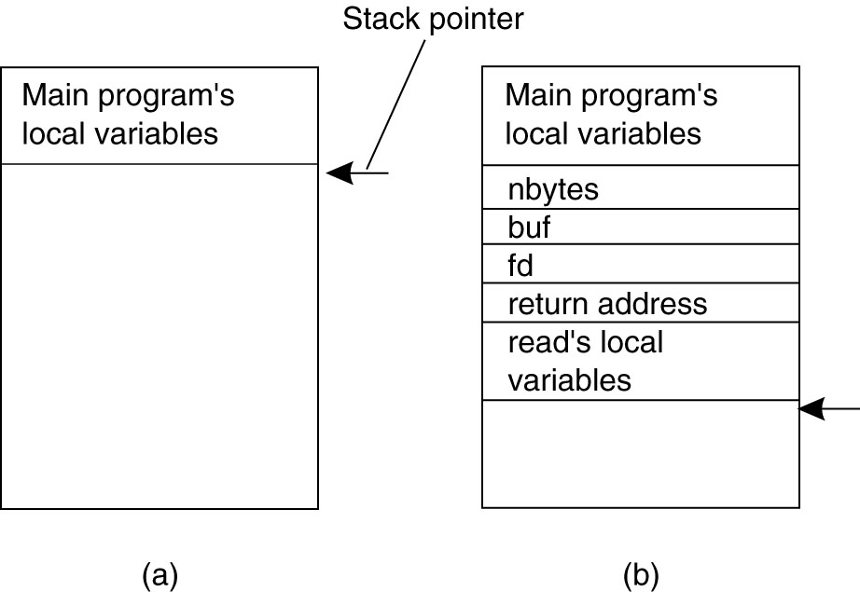
Conventional Procedure Call
Figure 4-5. (a) Parameter passing in a local procedure call: the stack before the call to read. (b) The stack while the called procedure is active.

Slide 9
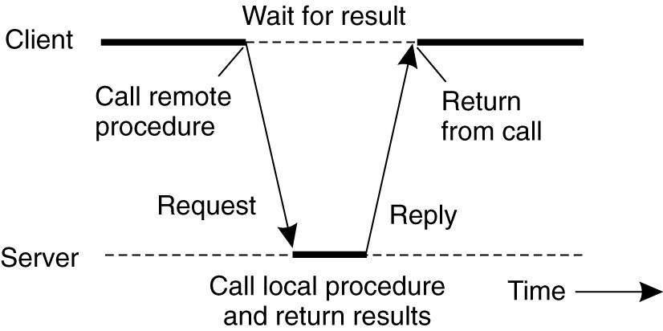
Client and Server Stubs
Figure 4-6. Principle of RPC between a client and server program.

Slide 10
Steps of a Remote Procedure Call
Client procedure calls client stub in normal way
Client stub builds message, calls local OS
Client's OS sends message to remote OS
Remote OS gives message to server stub
Server stub unpacks parameters, calls server
Server does work, returns result to the stub
Server stub packs it in message, calls local OS
Server's OS sends message to client's OS
Client's OS gives message to client stub
Stub unpacks result, returns to client

Slide 11
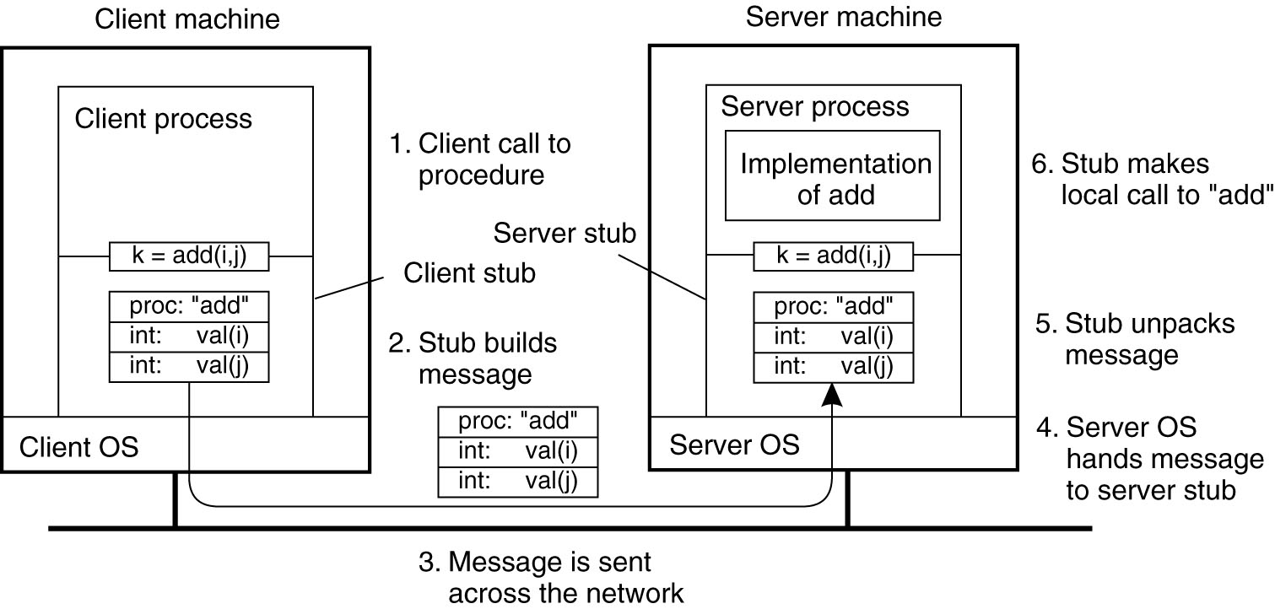
Passing Value Parameters (1)
Figure 4-7. The steps involved in a doing a remote computation through RPC.

Slide 12
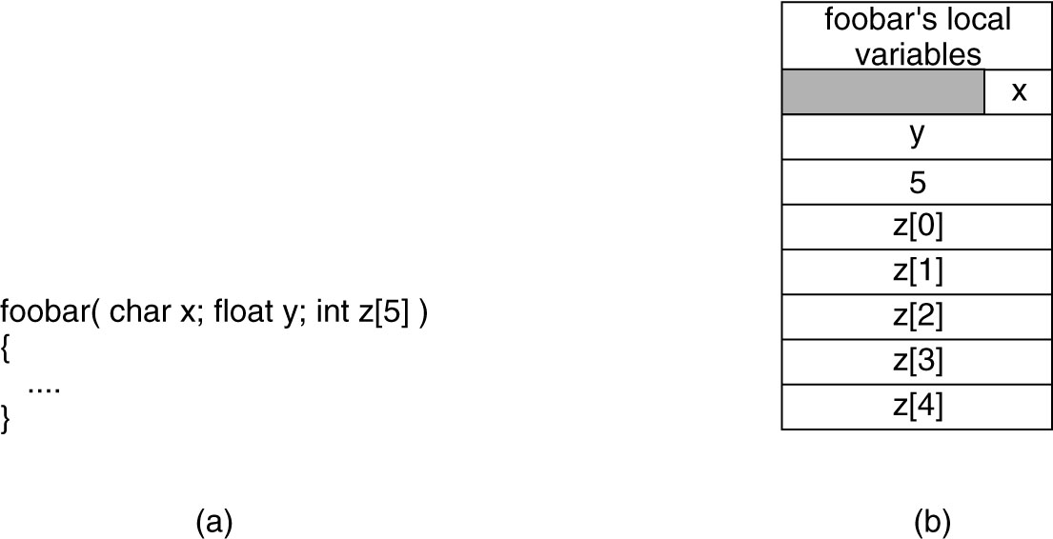
Parameter Specification and Stub Generation
Figure 4-9. (a) A procedure. (b) The corresponding message.

Slide 13
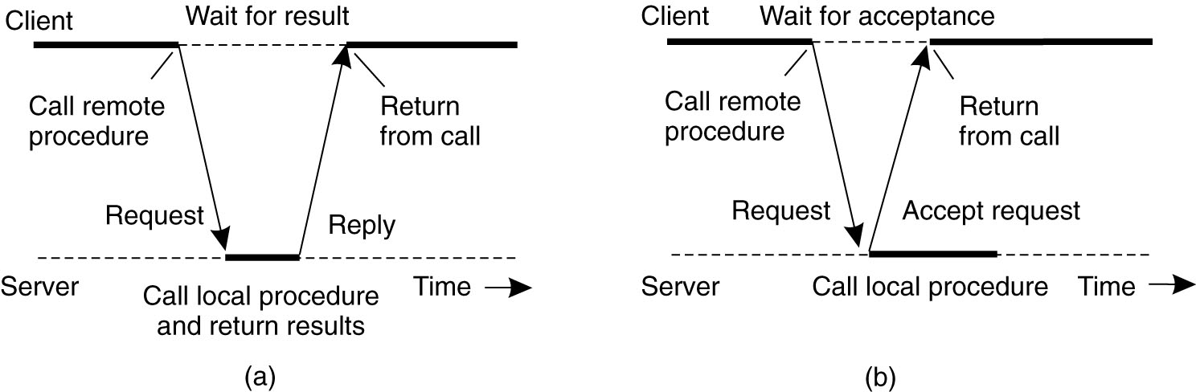
(A)synchronous RPC (1)
Figure 4-10. (a) The interaction between client and server in a traditional RPC.

Slide 14
Asynchronous RPC (2)
Figure 4-10. (b) The interaction using asynchronous RPC.

Slide 15
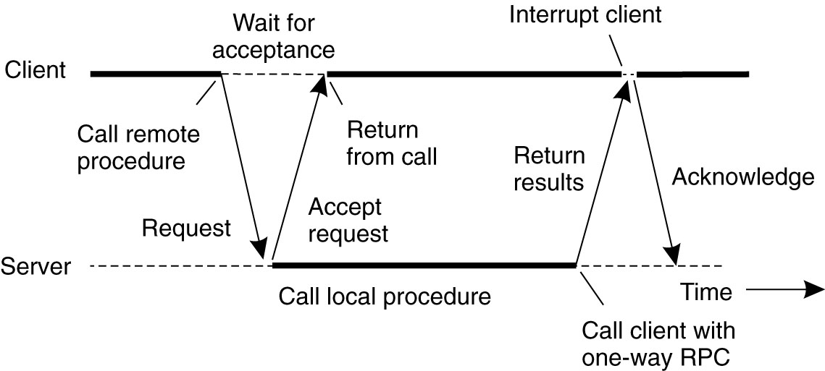
Asynchronous RPC (3)
Figure 4-11. A client and server interacting through two asynchronous RPCs.

Slide 16
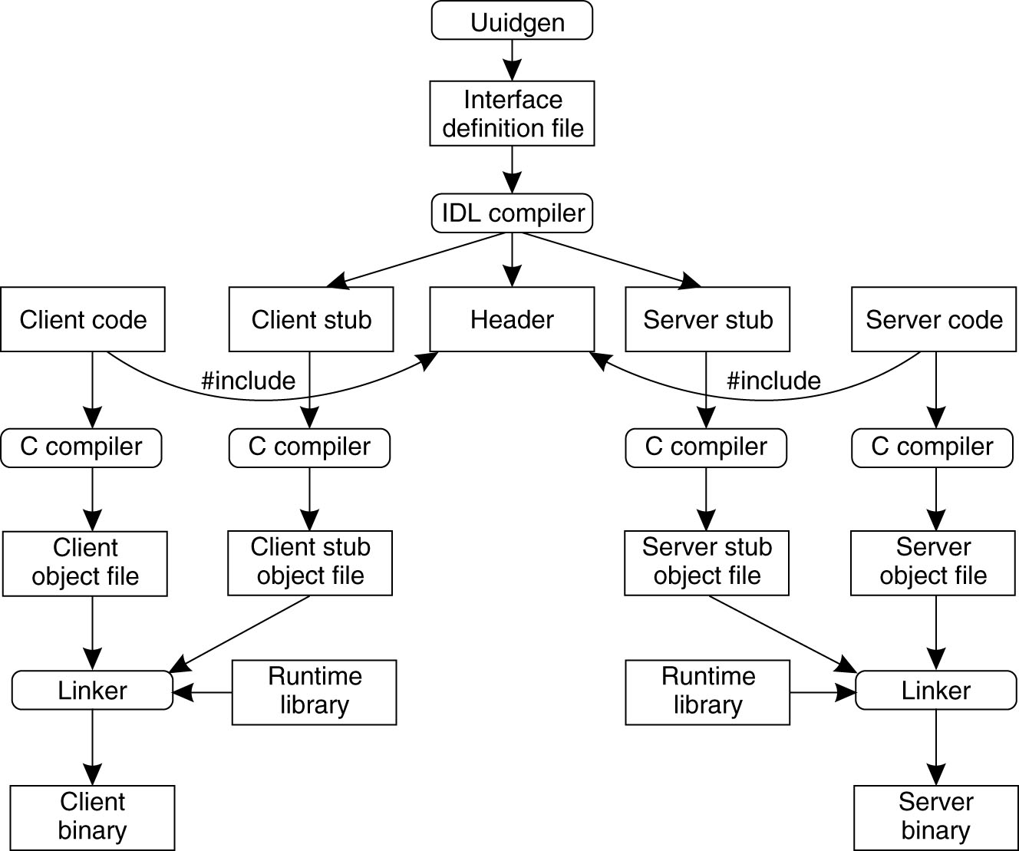
Writing a Client and a Server (1)
Figure 4-12. The steps in writing a client and a server in DCE RPC.

Slide 17
Writing a Client and a Server (2)
Three files output by the IDL compiler:
A header file (e.g., interface.h, in C terms).
The client stub.
The server stub.

Slide 18
Binding a Client to a Server (1)
Registration of a server makes it possible for a client to locate the server and bind to it.
Server location is done in two steps:
Locate the server’s machine.
Locate the server on that machine.

Slide 19
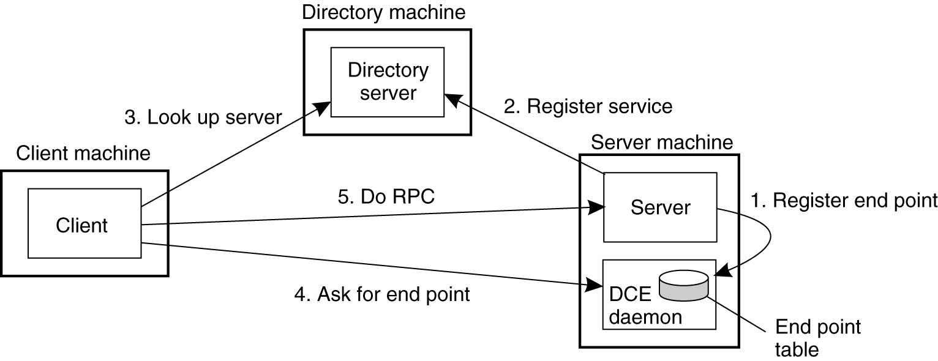
Binding a Client to a Server (2)
Figure 4-13. Client-to-server binding in DCE.

Slide 20
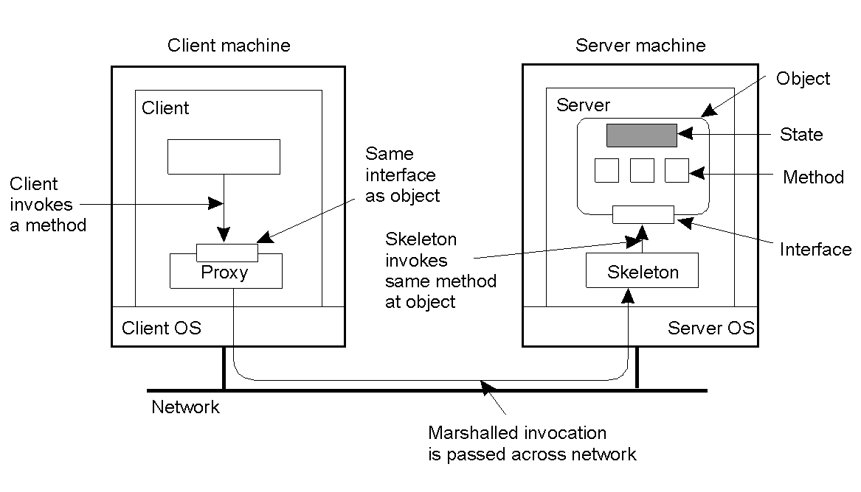
Distributed Objects
2-16
Common organization of a remote object with client-side proxy.

Slide 21
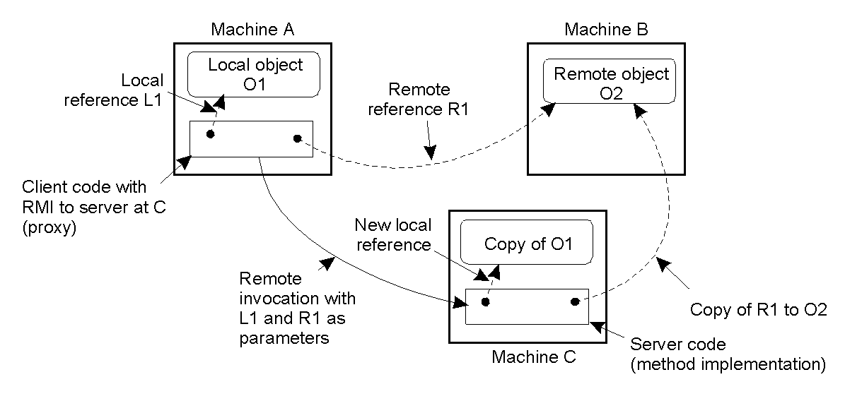
Parameter Passing
2-18
The situation when passing an object by reference or by value.

Slide 22
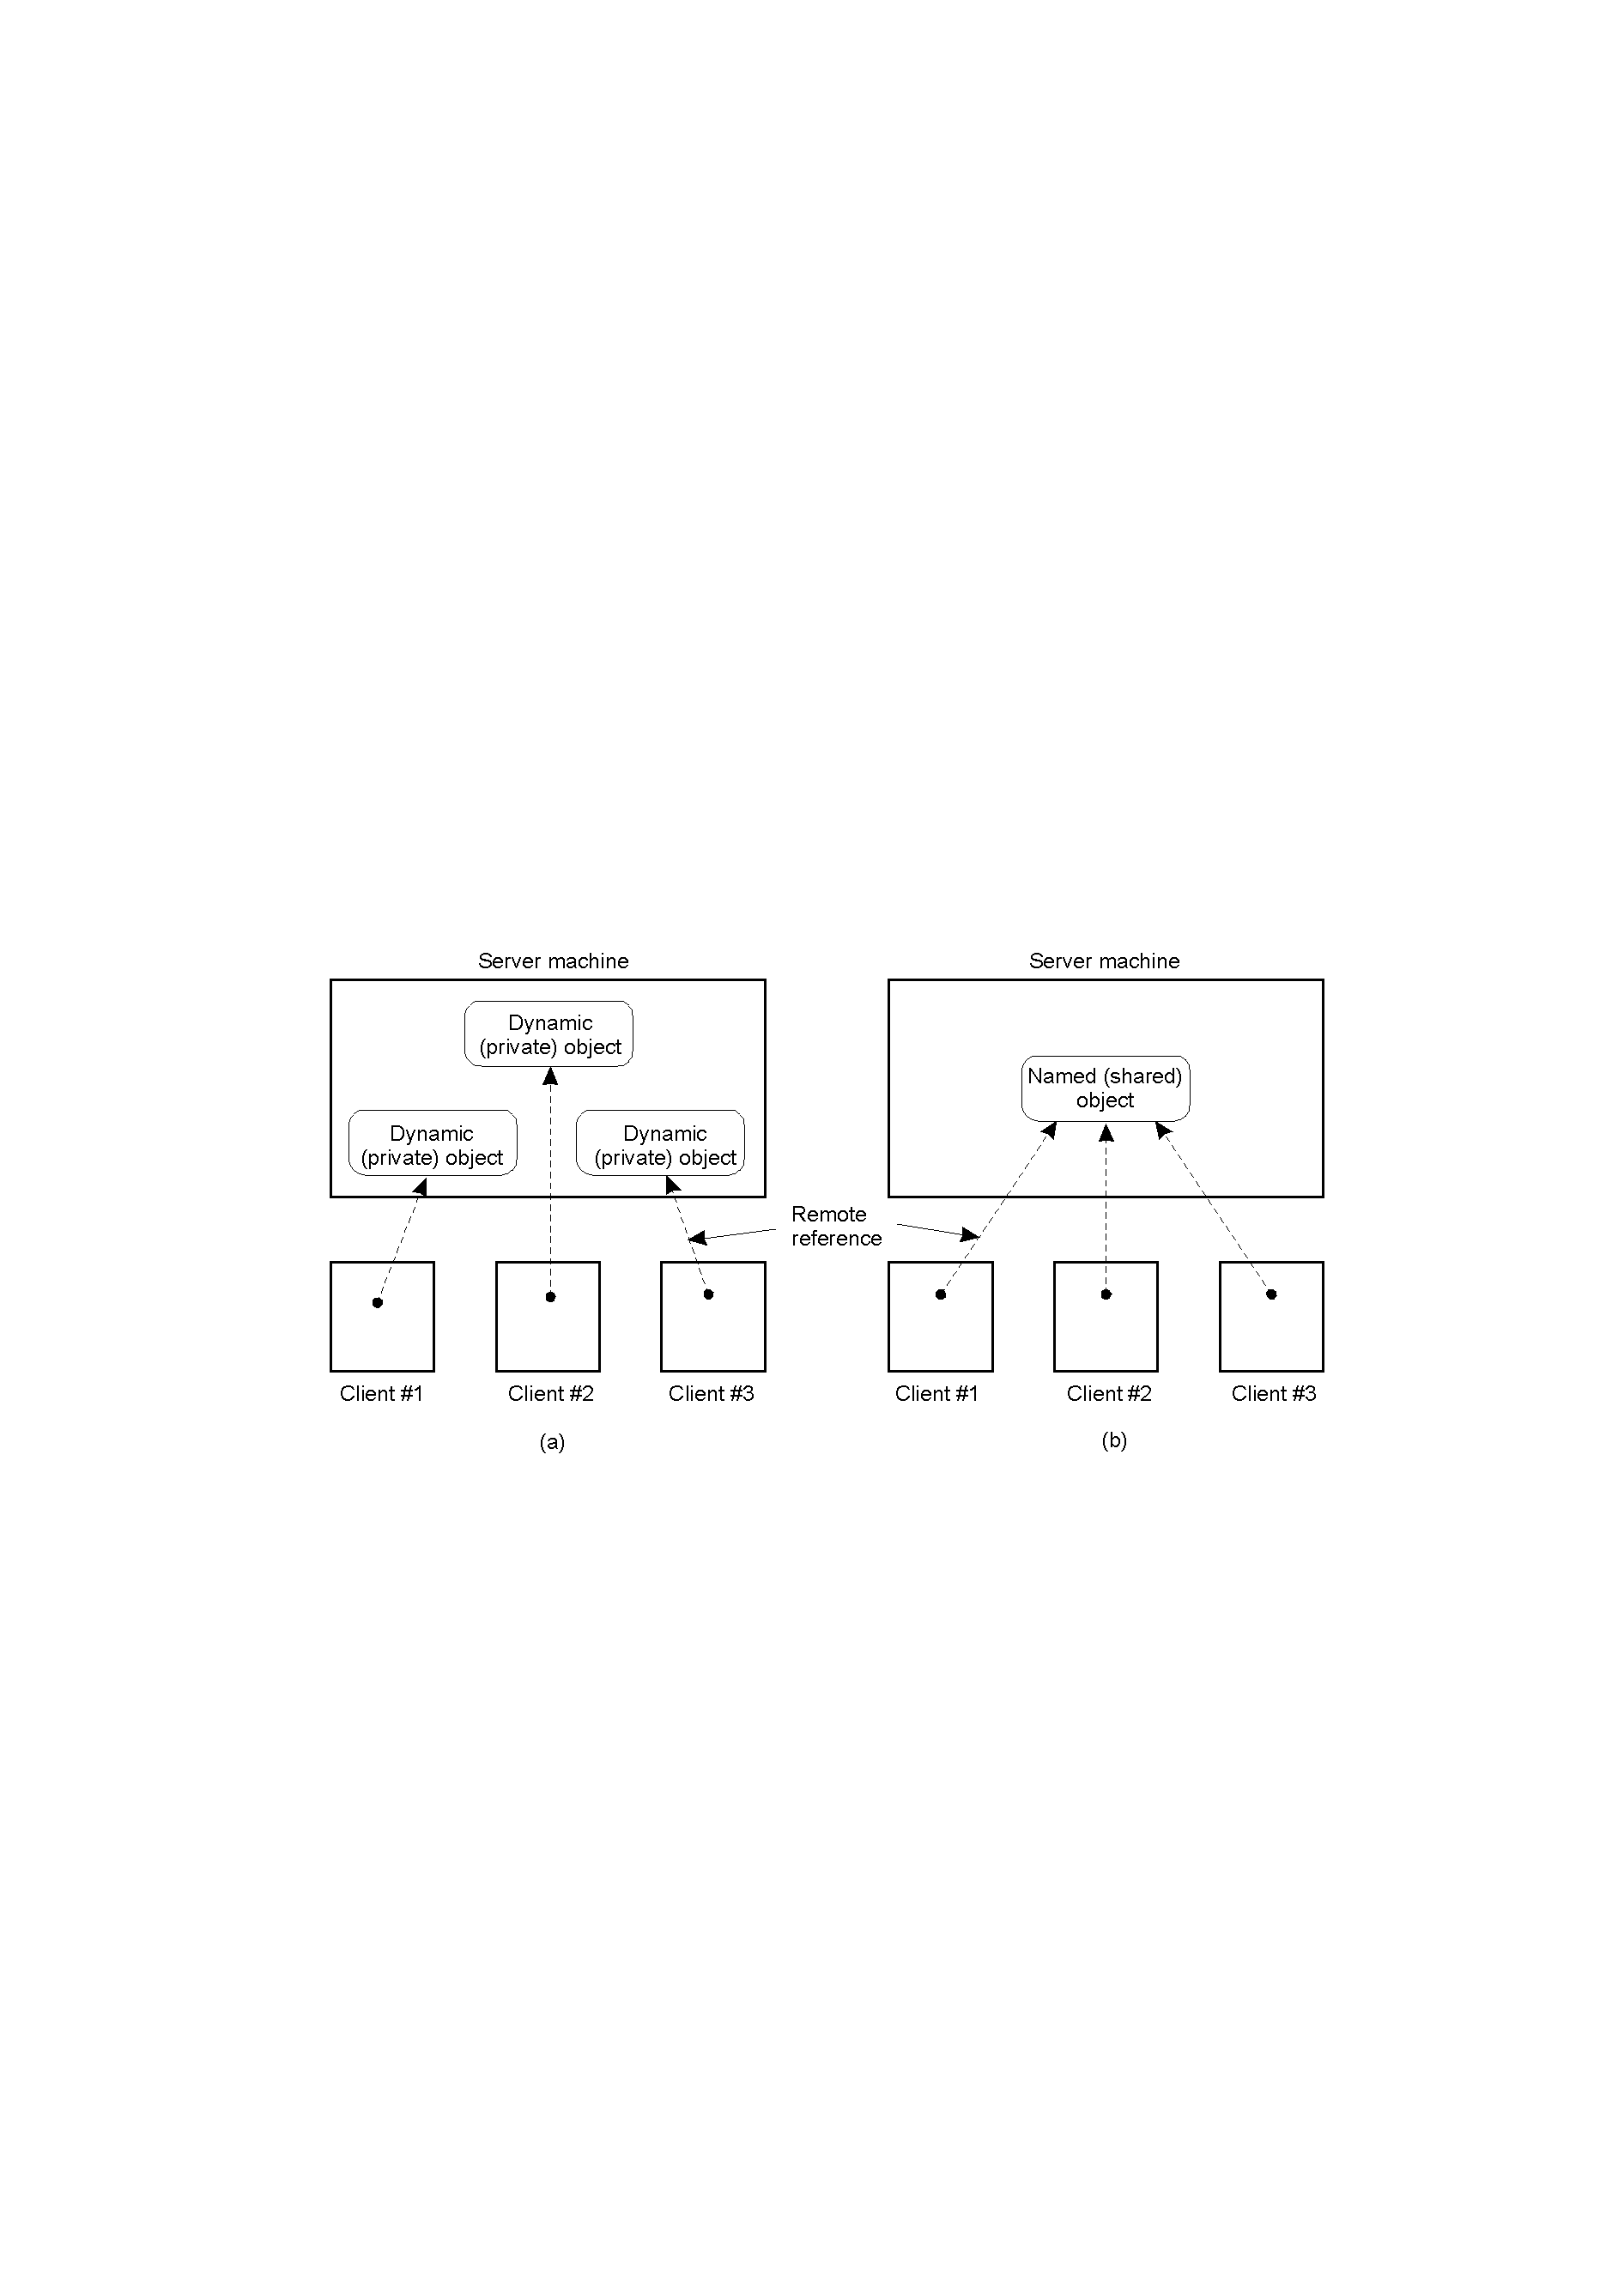
The DCE Distributed-Object Model
2-19
Distributed dynamic objects in DCE.
Distributed named objects

Slide 23
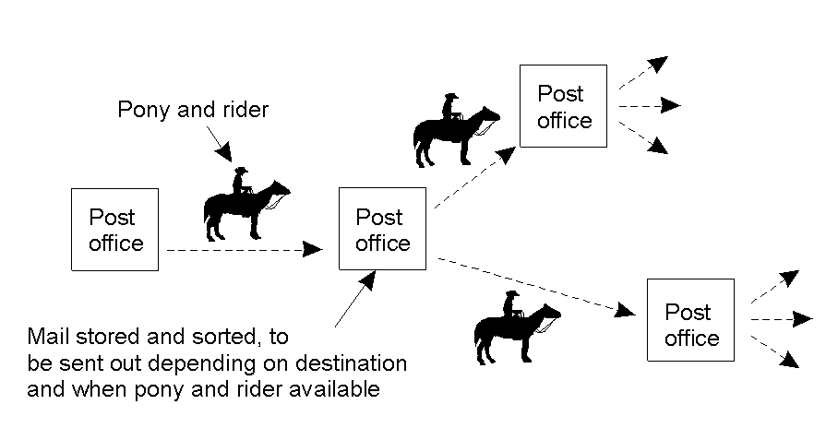
Persistence and Synchronicity in Communication (2)
Persistent communication of letters back in the days of the Pony Express.

Slide 24
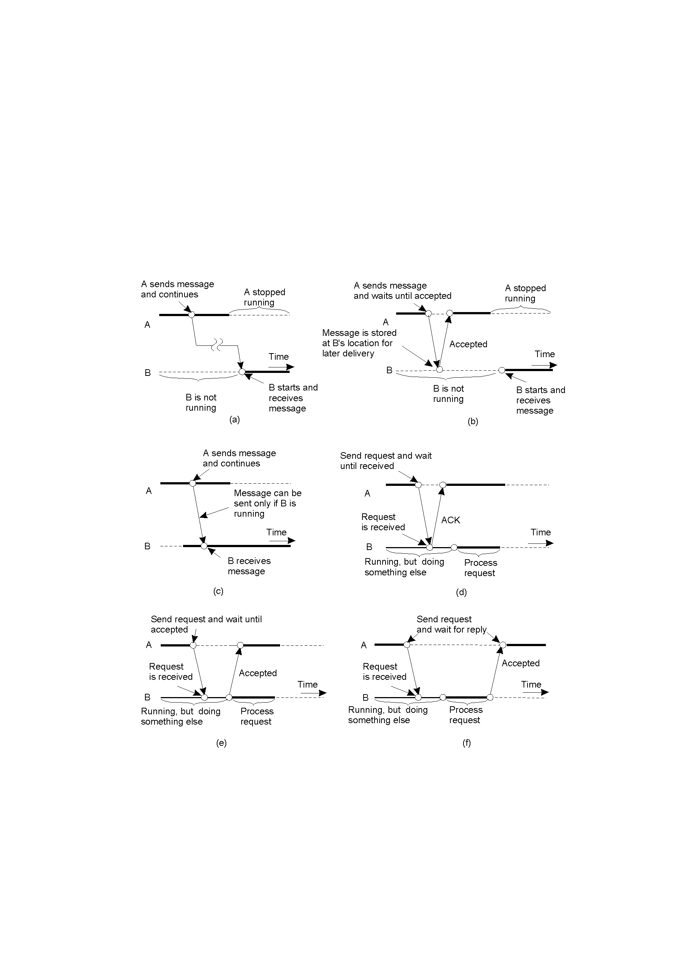
Persistence and Synchronicity in Communication (3)
2-22.1
Persistent asynchronous communication
Persistent synchronous communication

Slide 25
Persistence and Synchronicity in Communication (4)
2-22.2
Transient asynchronous communication
Receipt-based transient synchronous communication

Slide 26
Persistence and Synchronicity in Communication (5)
Delivery-based transient synchronous communication at message delivery
Response-based transient synchronous communication

Slide 27
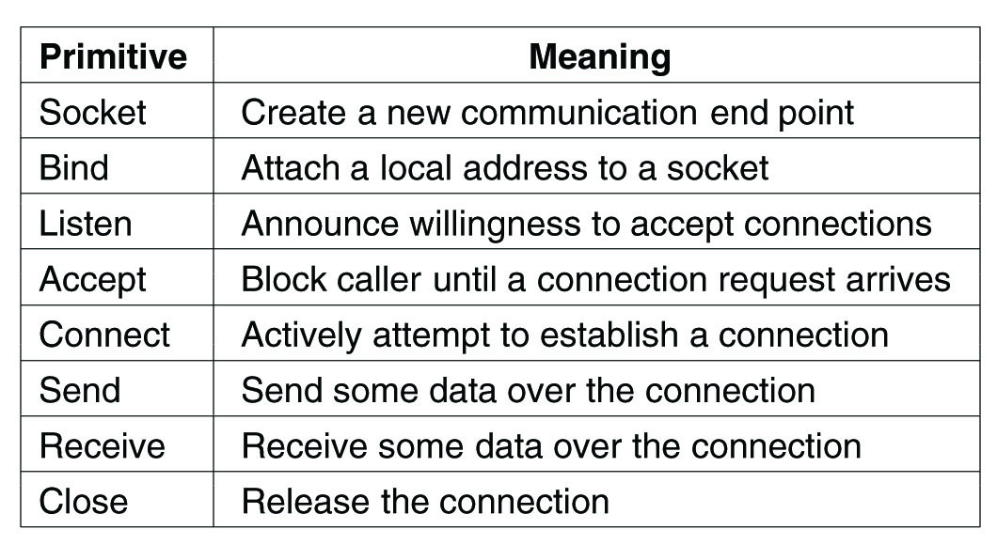
Berkeley Sockets
Figure 4-14. The socket primitives for TCP/IP.

Slide 28
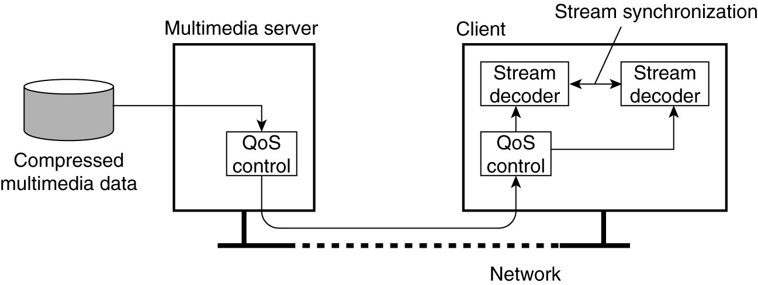
Data Stream
Figure 4-26. A general architecture for streaming stored multimedia data over a network.

Slide 29
Data stream
A sequence of data units
Can be used for sending discrete items such as with our JokeServers
Can be continuous, such as for audio or video

Slide 30
Asynchronous Transmission Mode
The data items are sent one after the other in sequence. No other timing constraints constraints.

Slide 31
Synchronous Transmission Mode
Maximum end-to-end delay
No constraint on arriving early.
Example is sensor data that is aggregated at intervals—must arrive in time, but no penalty if it arrives early.

Slide 32
Isochronous Transmission Mode
Data units are transferred on time
Cannot arrive late, and cannot arrive early
Early arrival can cause problems with buffer space.
Requires bounds on jitter—the variation in the transfer time between units.
Continuous data transfer using isochronous transfer mode is often simply referred to as streaming data

Slide 33
Complex vs. Simple Streams
Simple:
Sequenced data, homogenous
Complex
Two or more substreams that are related.
Stereo signal – two independent streams, but must be synchronized
Movies – Video image, up to six channels of audio (or more), subtitles in different languages, etc.

Slide 34
Continuous vs. discrete
Properties for Quality of Service:
Discrete, static media:
Text, still images, executables, objects
How to degrade signal? E.g. compromise between delay, or loss of some data?
Continuous media: sound files, movie files.
Temporary relationship is fundamental
How to degrade the signal? E.g., compromise between delay, or poor quality?

Slide 35
Properties of streaming data
Stored data streamed from files
Live data streamed from a real-time source
“Loop” delayed live streaming data
Compressed data—how much compression?
Secure data—how much overhead? authentication model at playback?

Slide 36
Audio timing is critical
Audio image is ephemeral and humans are very sensitive to it. By contrast the visual image tends to be stable.
External clocks for high-quality recordings can cost tens of thousands of dollars, working at billionths of a second
Audio imaging is also highly sensitive to timing issues, affecting meaning in the sound.
The difference between a $30,000 CD player and a $100 player usually is jitter

Slide 37
Modern sound
Up to 10.1 channels of sound
All must be carefully synchronized.
Clock timing, jitter, and synchronization are all crucial to good sound.
Sound can degrade in many ways:
Hard to understand spoken dialogue (often much worse than analogue)
Harsh sounding, or unpleasant, without quite realizing it. Affects body state.
Fatiguing to listen for long periods.

Slide 38
Many channels
Many surround sound channels
Video
Picture-in-picture track for commentary
Multiple subtitles
Alternate audio for director commentary, actor commentary, different languages…

Slide 39
Network level support – DiffServ on IP
Differentiated services, 6 bit header
Classify and mark packets by up to 64 (2⁶⁾ categories. But typical is only 4:
Default per-hop behavior (PHB): Best effort, depends on current circumstances
Expedited forwarding: Low loss, low delay, low jitter, no more than 30% total traffic
Voice Admit: EF, but limits number to avoid conflicts
Assured forwarding: assured up to a saturation level, then not

Slide 40
Streams and Quality of Service
Properties for Quality of Service:
The required bit rate at which data should be transported.
The maximum delay until a session has been set up
The maximum end-to-end delay .
The maximum delay variance, or jitter.
The maximum round-trip delay.

Slide 41
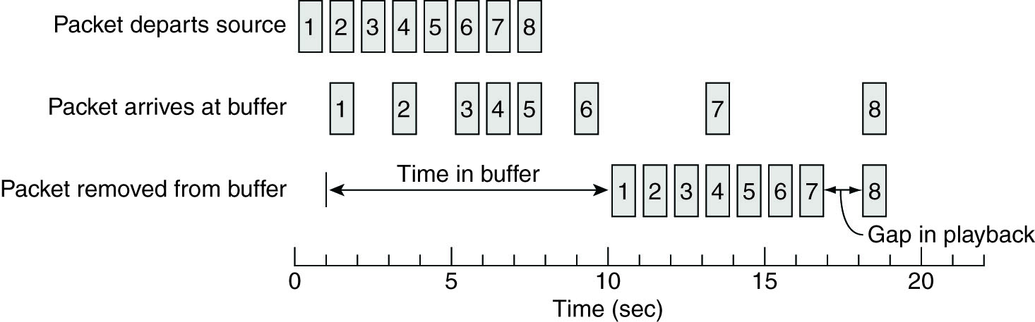
Enforcing QoS (1)
Figure 4-27. Using a buffer to reduce jitter.

Slide 42
Bigger Buffer….
To reduce jitter:
Constant average delivery is timely
The bigger the buffer, the better extremes are handled.
More delay in startup to fill the buffer part way.
Always a tradeoff, and prediction is important:
E.g. – how much do you fill the buffer at startup?

Slide 43
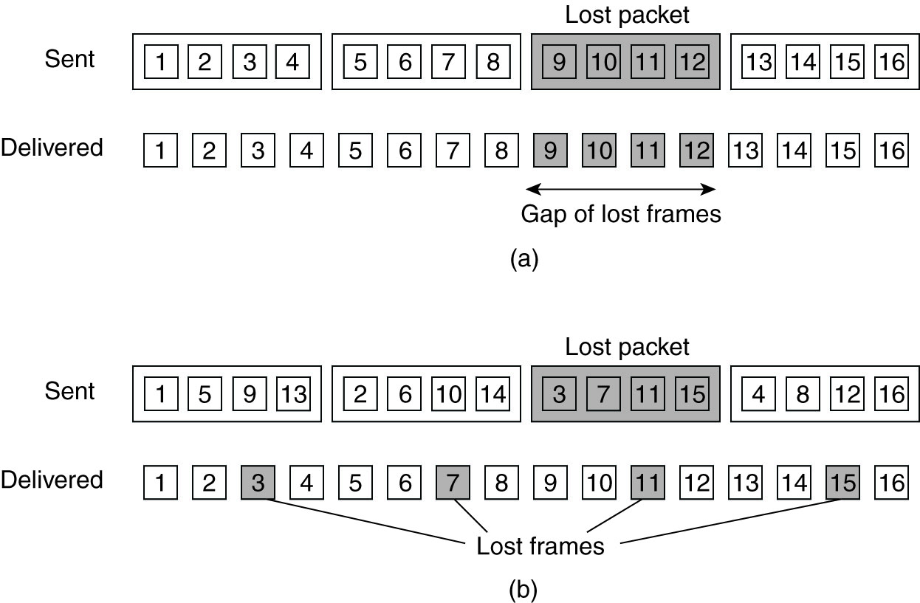
Enforcing QoS (2)
Figure 4-28. The effect of packet loss in (a) non interleaved transmission and (b) interleaved transmission.

Slide 44
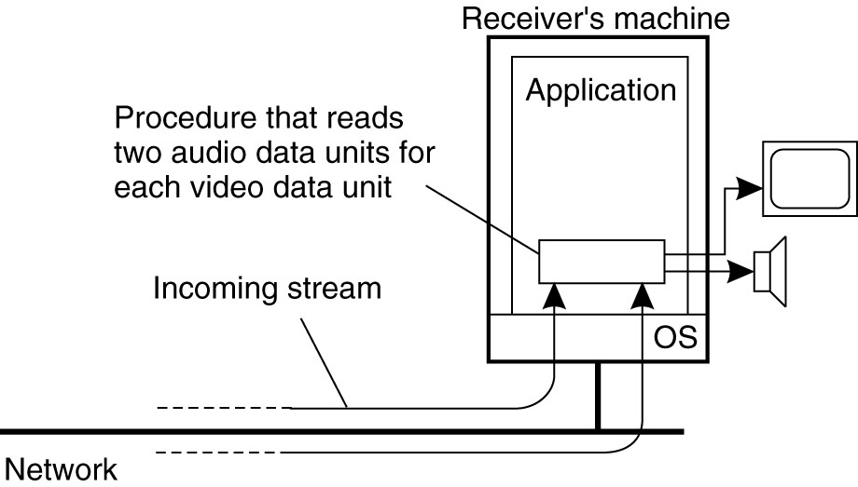
Synchronization Mechanisms (1)
Figure 4-29. The principle of explicit synchronization on the level data units.

Slide 45
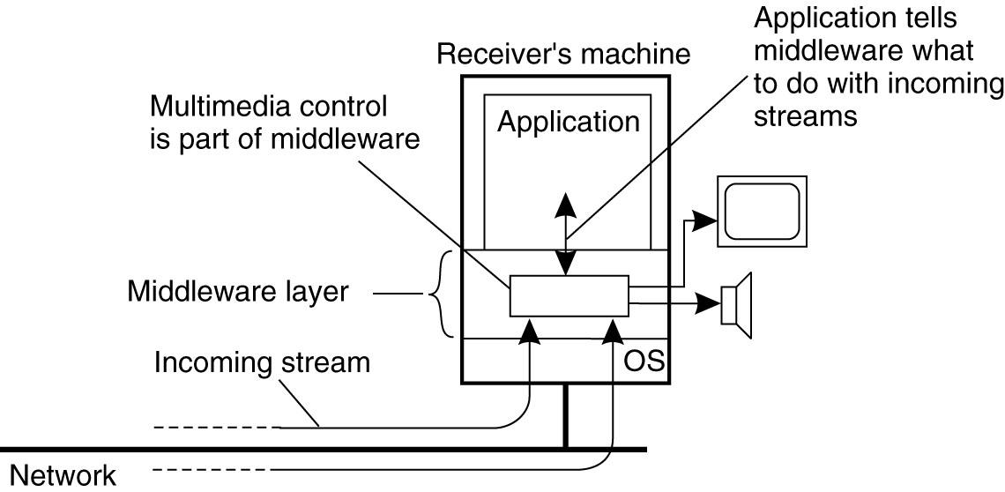
Synchronization Mechanisms (2)
Figure 4-30. The principle of synchronization as supported by high-level interfaces.

Slide 46
Multiplexing
As syncronization gets more complex, there is more need for real-time distribution of syncronization specifications
Multiplex all the data streams into one, and send the sync info too.
Motion Picture Experts Group (MPEG) standards
Can perform sync at sender if multiplexed, when receiver decodes, is already sync’d

Slide 47
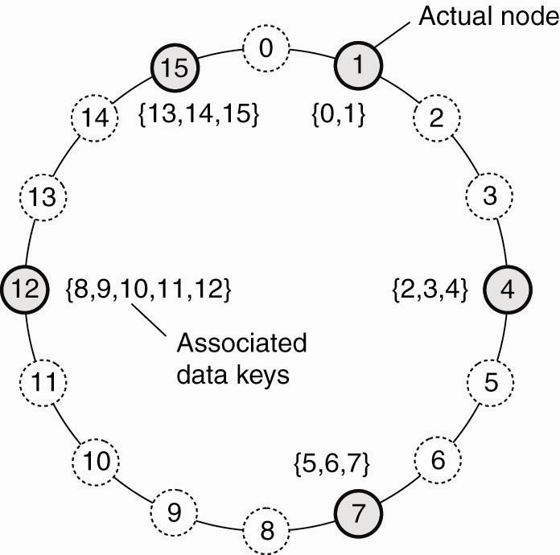
Structured Peer-to-Peer Architectures (1)
Figure 2-7. The mapping of data items onto nodes in Chord.

Slide 48
Application-level Multicast
Can cross router and network boundaries
May not be as efficient as network-level multicast
Must construct an overlay-network
Organized as a tree – one path to each node
…or as a mesh-network – multiple paths between pairs of nodes. This is more robust when a node fails – alternate paths.

Slide 49
MulticastTree from DHT (Chord)
Generate Multicast ID M_id, a hash value
Send build msg to succ(M_id) to DHT
Node becomes the root of the multicast group where messages are sent to be delivered to the group.
Any time a DHT node is added to the multicast group for M_id, [i.e., by the join(p, M_id) request] the request is passed along the DHT

Slide 50
If an intermediary DHT node has not seen a request before it becomes the parent of the new node in the multicast tree. Then it forwards a request, along the DHT path, for itself to be added to the multicast group as a “forwarder.” (It can, itself, join the group later by simply changing it’s own status.)
If the DHT node has already seen a request to join the multicast group M_id, it adds the node as its own child, and does not forward the request.

Slide 51
We can imagine, first, that nodes wishing to join the multicast group are independent of the DHT. In this way, a DHT node may have many children.
Now, imagine that ALL nodes belong to the DHT. Any node can now request of any other node that it join the multicast group.

Slide 52
Two types of nodes: pure forwarders, and forwarder-members.
To send a multicast message, just send it to SendMulticast[message, succ(M_id)]

Slide 53
In the following slide, there is a logical path from Node B to Node D but this is implemented via the intermediary physical path from Node A to Node C.
A packet that is multicast from Node A (A to B, A to C, B to D) might end up being sent twice over the physical path from A to C.

Slide 54
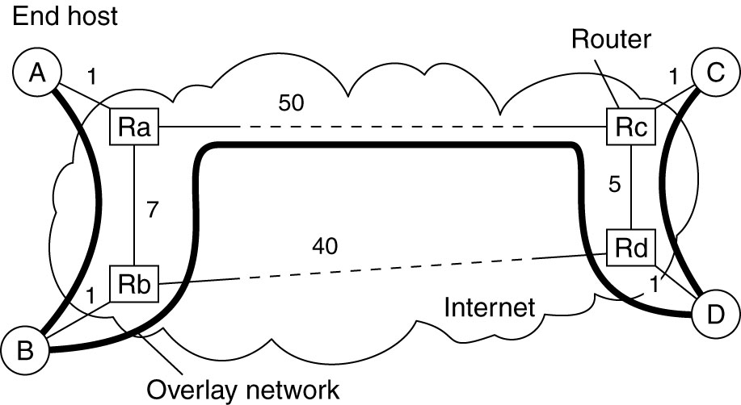
Overlay Construction
Figure 4-31. The relation between links in an overlay and actual network-level routes.

Slide 55
Gossip-based dissemination – Epidemic protocols
Simple algorithm
Robust
Needs only local information
A simplifying assumption is that sending is initiated by a single node, thus avoiding multiple-write problems.
Nodes are infected (Seen the msg), or susceptible (have not seen the msg).
A node is removed if not willing to infect others.

Slide 56
Information Dissemination Models (1)
Pick another node at random
Anti-entropy propagation model
Node P picks another node Q at random
Subsequently exchanges updates with Q
Approaches to exchanging updates
P only pushes its own updates to Q
P only pulls in new updates from Q
P and Q send updates to each other

Slide 57
Anti-entropy propagation model
Some node P in a network picks another node Q at random.
Then exchange updates with Q.

Slide 58
Push-only
P pushes its own update to Q
A-> B, C, D, E, F
D-> G, H, I, J
J-> K, L, M, N, O, P
How long to infect from A to P?
Bad choice for rapid updates.
Only infected nodes can propagate
Probability of selecting an already infected node increases as the message spreads.

Slide 59
Pull only
P only pulls a new update from Q
Works better when many are already infected
Triggered by susceptible nodes, works better to spread to them

Slide 60
Push-pull
Works best overall, though the others will work as well, and are simpler.
Depends on speed of spread requirements and efficiency needs
O(log(N)) “rounds” where a round is all nodes have chosen to exchange updates with some node, and N is number of nodes. So scales up.

Slide 61
Gossiping / rumor spreading
Keep telling the “hot news” until it appears that some number [“k”] of nodes have already heard the news, then get tired and give up. Approximate this with 1/k probability of giving up.

Slide 62
Gossiping / rumor spreading
Sometimes pure gossiping will leave some fraction of the nodes still not infected. Why keep gossiping if everyone you call already knows the gossip?
Combining gossip with anti-entropy can solve this problem.
The interaction between processes in gossip-based dissemination is small, so it tends to scale well.
Directional gossiping favors nodes with fewer network connections, considering them bridges to other parts of the graph.

Slide 63
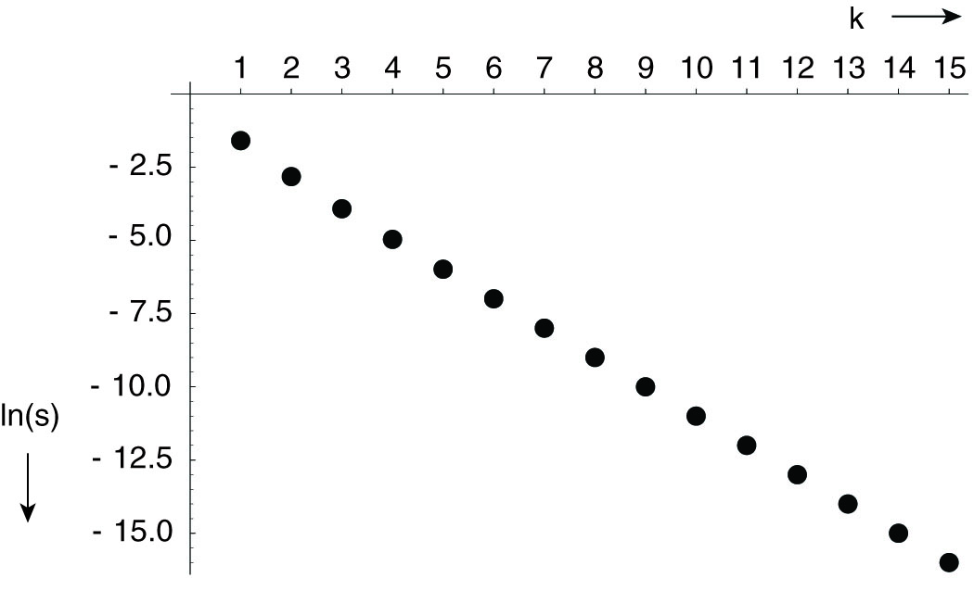
Information Dissemination Models (2)
Figure 4-32. The relation between the fraction s of update-ignorant nodes and the parameter k in pure gossiping. The graph displays ln(s) as a function of k.

Slide 64
Removing data in epidemics
The problem is that if all traces of the data have been removed, then later-arriving echoes of updates may unwittingly restore it.
Spread death-certificates instead. These mark data as deleted.
May wish to expire the death-certificates for cleanup.
Some nodes keep old certificates around so that if there is a late-arriving update, the death-certificate can be re-broadcast

Slide 65
Calculate the average of the network using an epidemic
For nodes j and i that trade values X then set X-i and X-j to be the value (X-i + X-j) / 2. [The average – just store this somewhere, this is the new value for X for the purpose of the calculation]
Over time all the nodes will have the average stored locally, and something close to it as time progresses

Slide 66
Calculate the size of the network using an epidemic
Some node q sets its X-q = 1.
All other nodes n set their X-n = 0.
For nodes j and i that trade values X then set X-i and X-j to be the value (X-i + X-j) / 2. [The average – just store this somewhere, this is the new value for X for the purpose of the calculation]
Over time all the nodes n will have a value from which they can calculate the size of the network as 1 / X-n.

